Slide 1


CAPSTONE PROJECT PRESENTATION
Predicting Future Hosts of Mutated Virus Strains through Machine Learning
TEAM MEMBERS:
Bhushan Sonawane
Rohit Kumar
Saba Anjum
Swastik Sourjeet
Venkat Vinay Randhi

Slide 2


Problem Statement
The challenge is to develop machine learning and deep learning models capable of accurately predicting the host class of viruses based on their DNA sequences. The project involves classifying viruses into one of eight distinct host classes: humans, plants, vertebrates, invertebrates, bacteria, eukaryotic microorganisms, archaea, and fungi. By addressing this problem, the project aims to contribute to our understanding of virus-host interactions, advance disease surveillance capabilities, and provide valuable insights into viral transmission patterns.
Aim:
Our aim is to create a dataset of viral DNA sequences and develop robust machine learning and deep learning models capable of classifying viruses into eight distinct host classes: humans, plants, vertebrates, invertebrates, bacteria, eukaryotic microorganisms, archaea, and fungi. By accurately predicting viral host specificity, we can gain valuable insights into virus-host interactions, facilitate disease surveillance, and enhance our understanding of viral transmission patterns

Slide 3
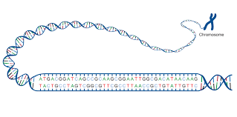
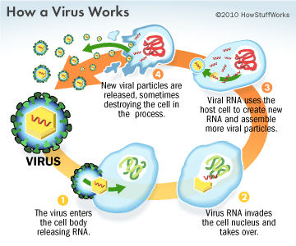
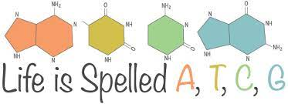
INTRODUCTION
hosts
archae
bacteria
invertebrates
fungi
Eukaryoyic microorganisms
humans
vertebrates
plants

Slide 4
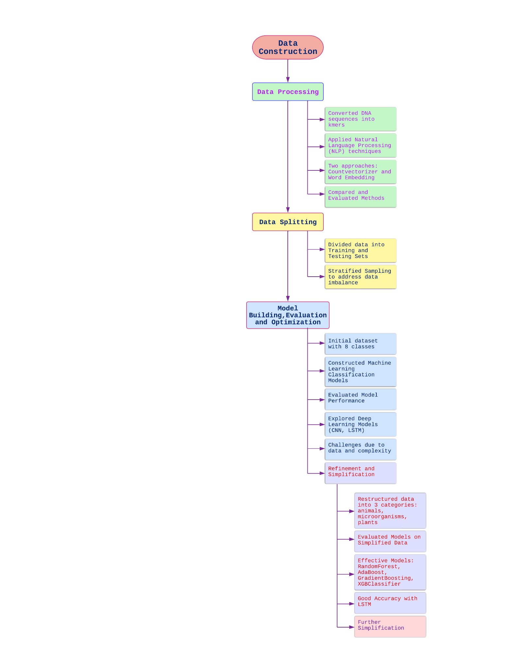
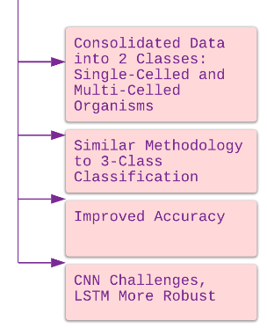

Slide 5
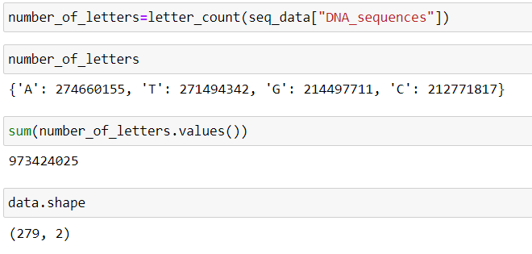
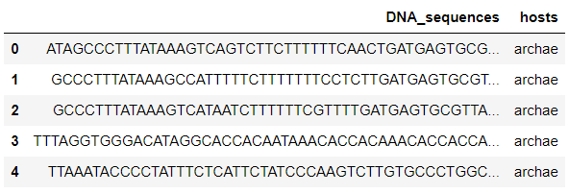
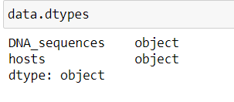
1) Data Construction
Obtain Data from ViralZone Database(viralzone.expasy.org) and NCBI(national centre for biotechnology information)
Retrieve Viral DNA Sequences in FASTA format
Select 35 sequences from each host class
Ensure dataset balance across host classes
Data Description:

Slide 6
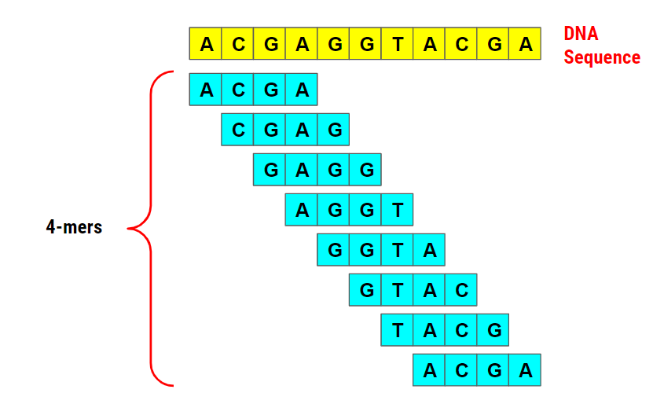
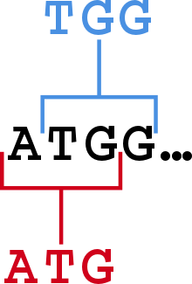
DATA PREPROCESSING:
2) Data Cleaning
To remove characters from the DNA sequences that are either non-standard or do not convey specific nucleotide information('Y', 'M', 'R', 'N', 's', 'S', 'K', and 'W’ )
Newline character '\n' is removed to ensure that sequences are in a clean, continuous format.
3) Encoding the hosts columns
The label encoding process is applied to the "hosts" column from the data, which presumably contains categorical host labels (e.g., "human," "vertebrates," etc.).
These numerical labels can be used as target variables in machine learning models.
4) Converting Sequences into Kmers
Kmer : analysis, genome assembly, and feature extractiosequence of 'k' nucleotide bases (e.g., A, T, G, C) taken from a longer DNA sequence.
widely used in tasks like sequence n because they capture local patterns within DNA sequences

Slide 7
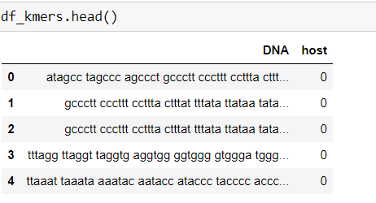
K-mers serve as a compact and informative representation of DNA sequences.
They capture local sequence patterns, which can be crucial for various tasks, including:
DNA sequence classification (predicting host labels, as our your case).
Sequence alignment.
Identifying sequence motifs (recurring patterns).
Detecting mutations or variations.
K-mers are often used as input features for machine learning models to predict or classify biological properties or behaviors based on DNA sequences.
5) SPLITTING THE DATA INTO TRAIN AND TEST SPLIT
The data was split into train and test split with a test size of 0.3
6) DATA TRANSFORMATION:
Used Count Vectorizer for data transformation, which involves classifying DNA sequences into different host categories, was found to be a suitable choice.
Simple and Interpretable
Preservation of Sequence Information
No Loss of Information
Compatibility with Various Models

Slide 8
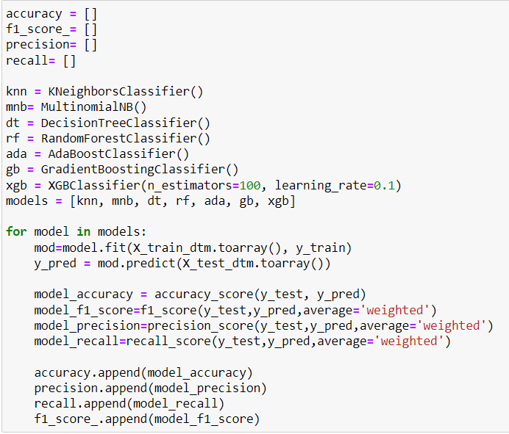
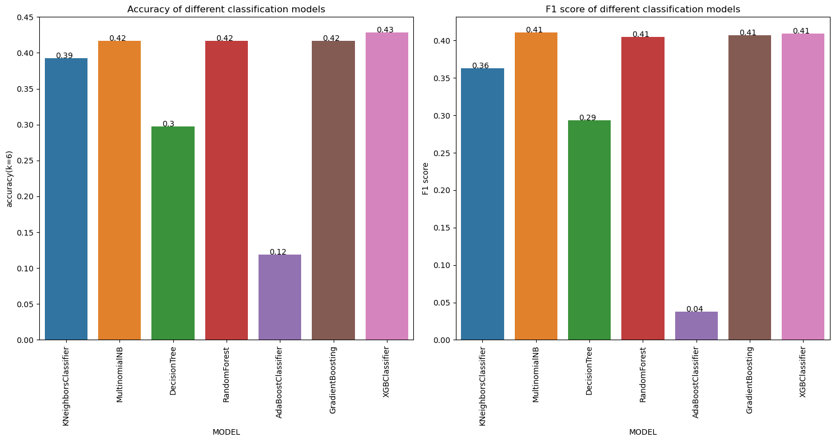
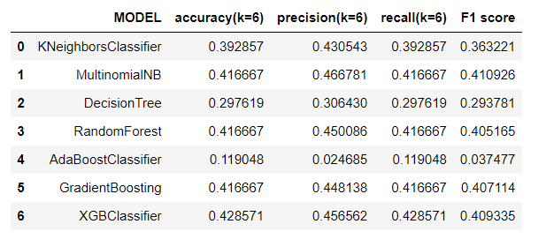












MODEL BUILDING
K-Nearest Neighbours
Multinomial naïve bayes classifier
Decision tree classifier
Random forest classifier
Ensemble models(Adaboost classifier, Gradient boosting classifier,XGBoost classifier)
Evaluation metrics
as correctly identifying the viral host is of utmost importance, we must prioritize metrics like recall and specificity. Considering a balance between precision and recall, the F1-Score could be appropriate. To gain a comprehensive understanding of model's performance we have used multiple metrics.

Slide 9
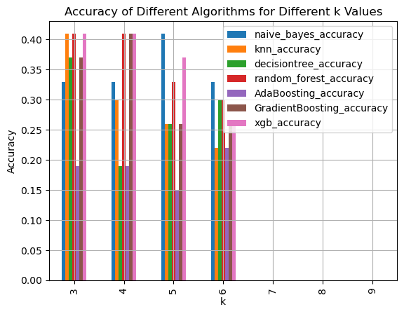
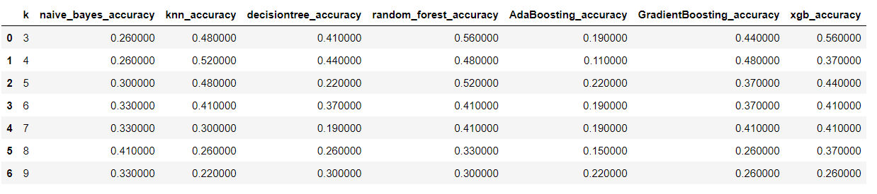
MODEL OPTIMIZATION
Model optimization by varying for values of k:
The aim of various k-mer sizes is to attained a suitable size. A lower k-mer size will store the DNA sequence with the less amount of space and if we choose smaller kmer that it also lose our Informat.
Larger sized k-mers will take more memory to store the DNA sequence. Larger k-mer sizes assist to solve the problem of small recurrent regions. So we choose that type of k value that give optimum accuracy.
The highest accuracy is achieved with k value 3 and 5 with models xgboost and random forest.
A lower k-mer size will store the DNA sequence with the less amount of space and if we choose smaller kmer that it also lose our Information.
Larger k-mer sizes assist to solve the problem of small recurrent regions.hence we can go for kmer size as 5.

Slide 10
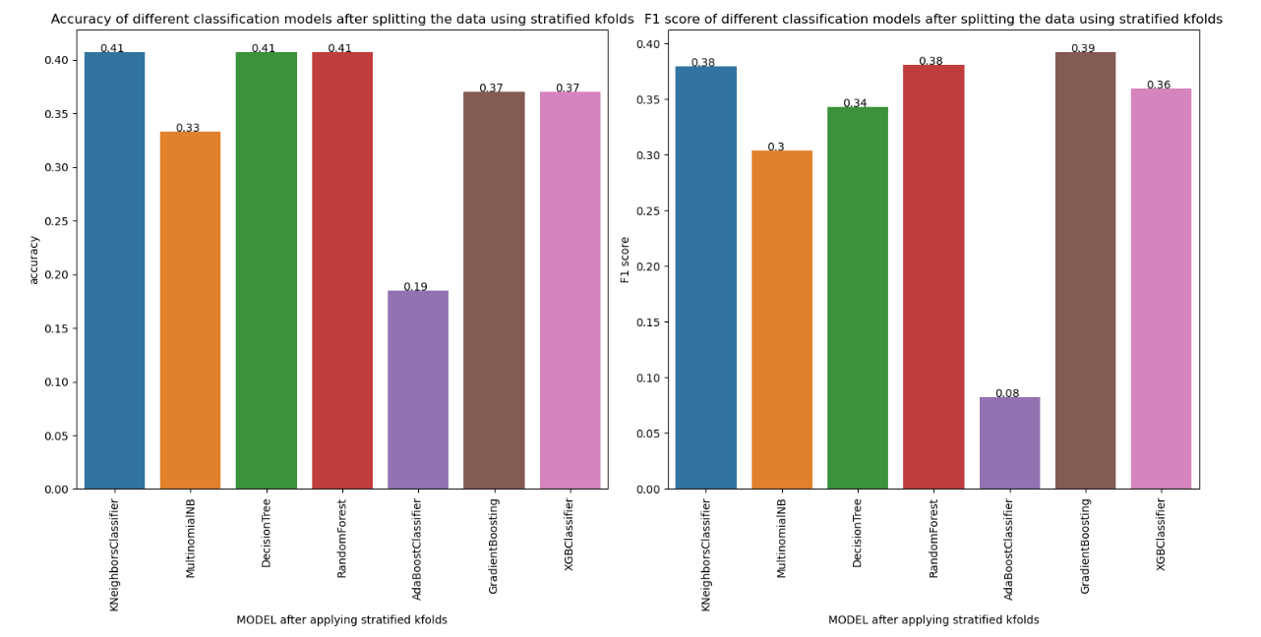
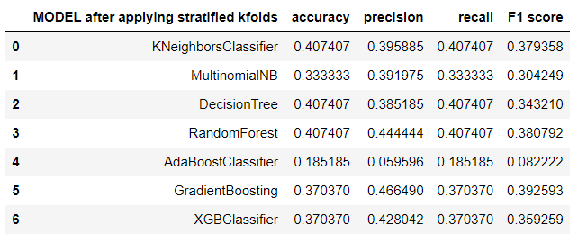
Hyperparameters Tuning:
multinomial naive bayes, random forest, gradient boosting and xgbclassifier have given the highest accuracy,precision,recall and f1 score,tuning the hyperparameters using GridsearchCV
The evaluation metrices did not show a significant rise which means that there was no significant improvement in the models after the hyperparameter tuning. This suggests that the default values of parameters in the model worked the best for these classification models.
Using stratified k folds for the train test split:
imbalanced training and testing sets result in biased models that perform well on the majority class but struggle with the minority classes.
The overall performance of the models remained consistent in terms of accuracy and F1 score, there were variations in their capabilities.

Slide 11
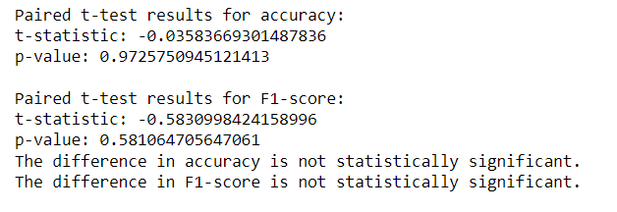
Statistical test to validate whether there is significant difference in the model performances after using stratified k folds to split the train and test data:
Null Hypothesis (H0): There is no significant difference in performance between the two approaches.
Alternative Hypothesis (H1): There is a significant difference in performance between the two approaches.
Since the p value was greater than 0.05, Hence there is no significant difference or improvement in the accuracy or F1 score after using stratified Kfolds for splitting the train and test data.
We used hyper parameter tuning to improve the model but no increase in the accuracy of models after the hyperparameter tuning, suggest that the algorithm's default parameters work best with the data.

Slide 12
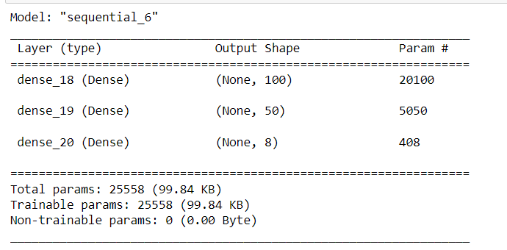
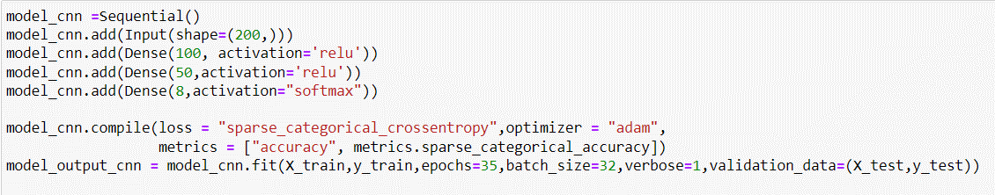
DEEP LEARNING MODELS:
CNN
Can capture local patterns and motifs within the DNA sequences, which can be informative for predicting viral host specificity.
Have shown impressive performance in various bioinformatics tasks, including DNA sequence classification, and can automatically learn hierarchical features from the data.
Data transformation(word embedding ):
For data transformation, word embedding was used. Word embeddings are typically considered a better method than count vectorization for deep learning models when working with text data.
For deep learning models such as convolution neural networks (CNNs, using word embeddings as input data is often the preferred choice. It allows model to understand the semantic and contextual information within the DNA sequence data, potentially leading to better results compared to count vectorization, which lacks these advantages.

Slide 13
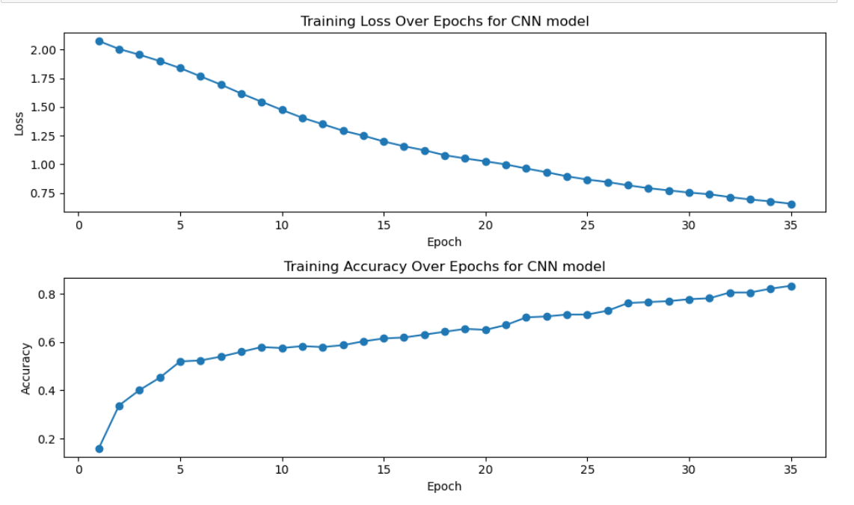
Training Performance: increased from approximately 15.87% to about 83.33%.
Validation Performance: The validation accuracy also improved throughout training, reaching approximately 51.85% by the end. This suggests that the model was learning to generalize well to the validation data.
Test Performance: When evaluated on the test dataset, the model achieved an accuracy of about 51.85%.
Loss: The loss, which measures the error during training, steadily decreased throughout the training process
In summary, the neural network model showed good training, validation, and test performance, with the ability to generalize to unseen data. The accuracy on the test dataset reached approximately 51.85%, indicating that the model performed reasonably well in classifying samples into the 8 defined classes.

Slide 14
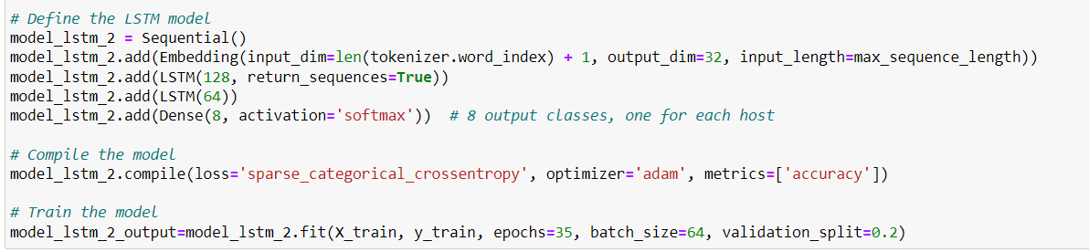
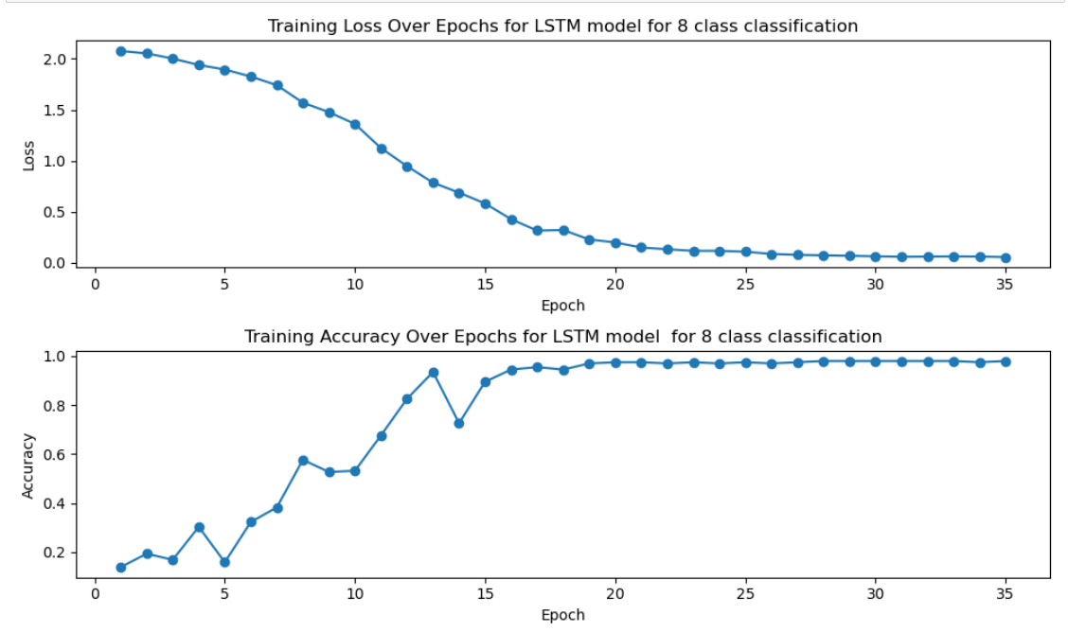
LSTM
designed for sequential data, which is a natural fit for DNA sequences.
ability to process sequences of variable lengths and capture long-range dependencies between DNA bases.
can be initialised with pre-trained embeddings, which can capture useful information about DNA bases from large-scale genomic datasets.
Transfer learning from related tasks can be leveraged to improve model performance, even with limited viral genomic data.
Training Performance: training accuracy improved steadily over the epochs, reaching approximately 98.01% accuracy by the final epoch.
Validation Performance: remained relatively low, around 0.00% throughout the training process. This suggests a potential issue with overfitting, where the model performs well on the training data but fails to generalize to new, unseen data.
Test Performance: achieved an accuracy of approximately 29.63%. This result is consistent with the low validation accuracy, indicates that the model struggled to generalize to the test data.
In summary, the CNN model achieved high training accuracy but struggled to generalize to both the validation and test datasets, indicating potential overfitting. Further optimization and regularization techniques may be needed to improve its generalization performance

Slide 15
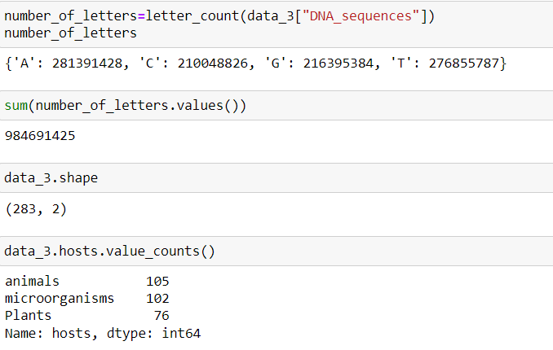
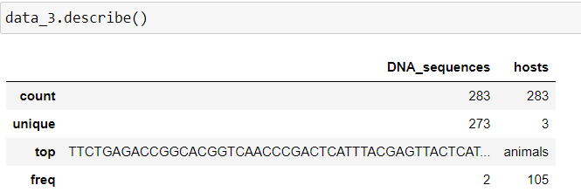
Due to we challenges faced because of limited data and model performance, it can be considered to simplify the classes as needed.
Hence, we reduced the number of classes from 8 classes to 3 classes which are plants, animals and microorganisms.
Reasons to reduce the number of classes:
Data Availability: Combining classes balances data for better model training.
Model Complexity: Fewer classes simplify the problem for models.
Scientific Focus: New categories align with research goals.
Interpretability: Fewer classes mean clearer results.
Practicality: Simpler classes ease implementation and communication.
New Class Categories:
The three new host class categories are as follows:
Plants: This category comprises viruses that infect plant organisms.
Animals: Animals encompass various host organisms, including humans, vertebrates, and invertebrates.
Microorganisms: This category accommodates viruses that infect microorganisms, including Archaea, Bacteria, Eukaryotic Microorganisms, and Fungi.
Data description:

Slide 16
DATA CLEANING
Whitespace Removal
Removal of Special Characters
By meticulously cleaning the data, we ensured that our DNA sequences were devoid of irrelevant characters and ready for subsequent modeling
DATA TRANSFORMATION:
Label Encoding
K-mer Conversion
Count Vectorization
Addressing Class Imbalance: Recognizing the class imbalance issue, we implemented the Synthetic Minority Over-sampling Technique (SMOTE) for oversampling.
Train test split: used to create the training and test data with a test size of 0.3
MODELLING BUILDING:
K-Nearest Neighbours
Multinomial naïve bayes classifier
Decision tree classifier
Random forest classifier
Ensemble models(Adaboost classifier, Gradient boosting classifier,XGBoost classifier)

Slide 17
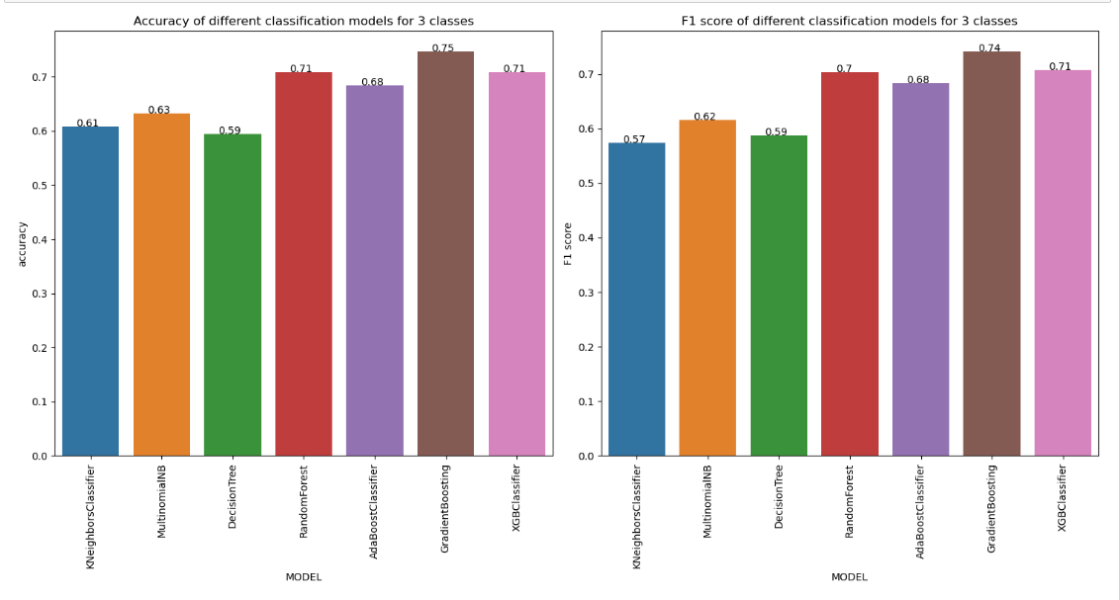
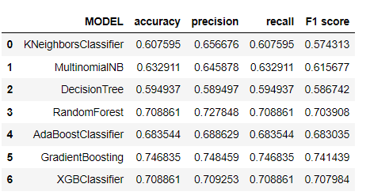
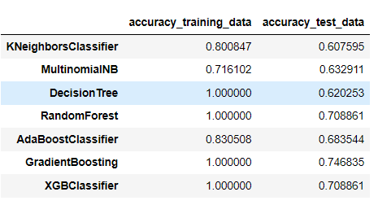
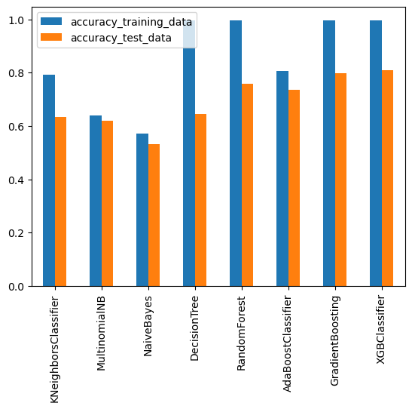
Evaluation metrics for 3 class classification model:
Evaluating the training and test accuracy of models:
RandomForest: perfect training accuracy, which is a strong sign of overfitting. test accuracy is higher than some models but still suggests overfitting.
AdaBoostClassifier: showing some overfitting, appears to generalize slightly better than the DecisionTree and RandomForest.
GradientBoosting and XGBClassifier: models exhibit overfitting, as their training accuracies are perfect (1.0), but test accuracies are lower.

Slide 18
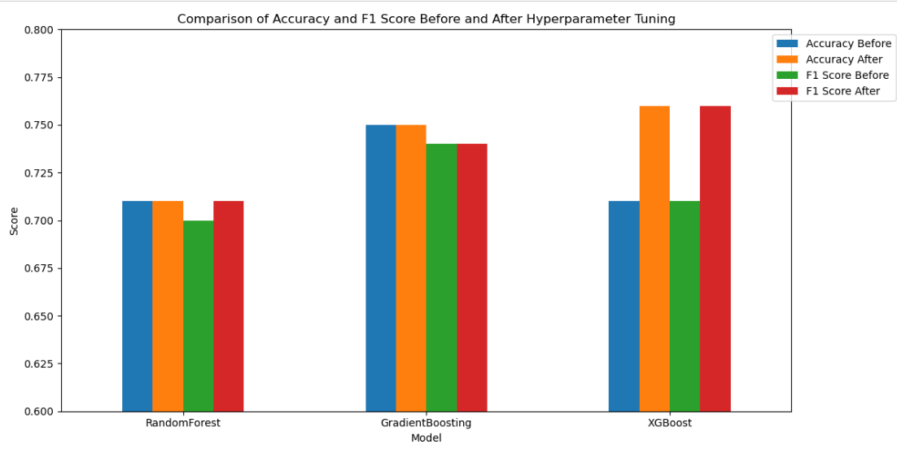
MODEL OPTIMIZATION:
Hyperparameter tuning was used to optimize the model. We used gridsearchcv and randomized search methods to tune the hyperparameters for different model
Comparing the accuracy and F1 score before and after hyperparameter tuning
In general, the models demonstrated reasonable performance in classifying DNA sequences into three categories (plants, animals, microorganisms) before hyperparameter tuning.
RandomForest, GradientBoosting, and XGBClassifier initially exhibited the highest accuracy among the models. However, after hyperparameter tuning, the performance of these models further improved, as described in the previous responses.
The hyperparameter tuning process effectively optimized the model parameters, enhancing the classification performance
XGBClassifier emerged as the top-performing classifier with the highest accuracy, precision, recall, and F1 score of 0.76,0.76,0.75,0.77 respectively after tuning.
XGBoost,choice for classifying DNA sequences into the specified categories

Slide 19
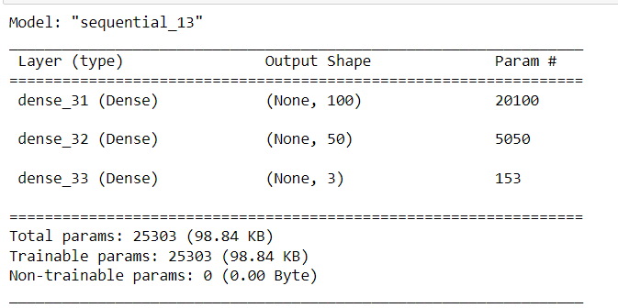
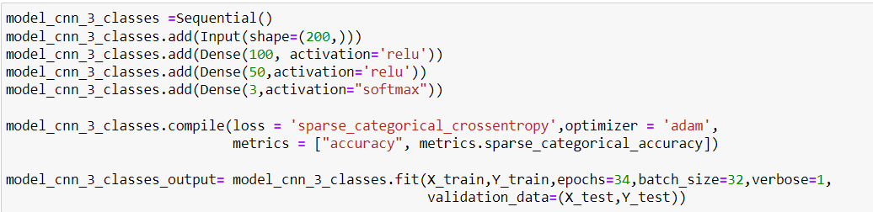
DEEP LEARNING MODELS
Data Transformation:
K-mers Generation
Feature Extraction with Word2Vec: A DocToVec class is defined to convert k-mers into numerical vectors. It uses Word2Vec to represent individual words in the k-mers
Embedding K-mers: The k-mers are embedded into numerical vectors using the DocToVec class, resulting in a vector representation for each DNA sequence.
Label Encoding: The target labels (hosts) are encoded into numerical values using Label Encoding.
CNN MODEL FOR THREE CLASS CLASSIFICATION:

Slide 20
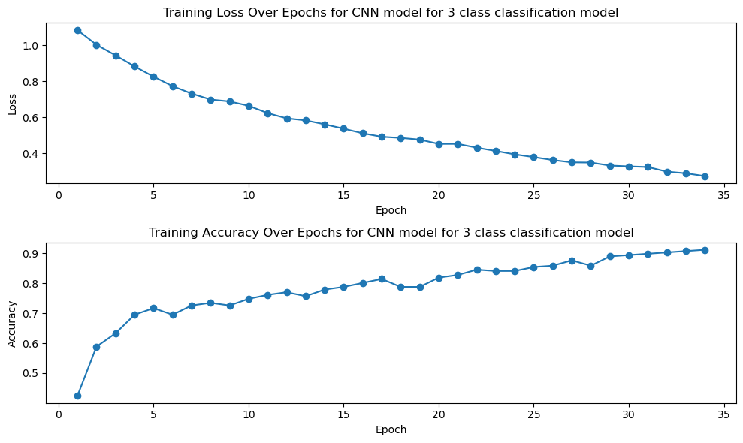
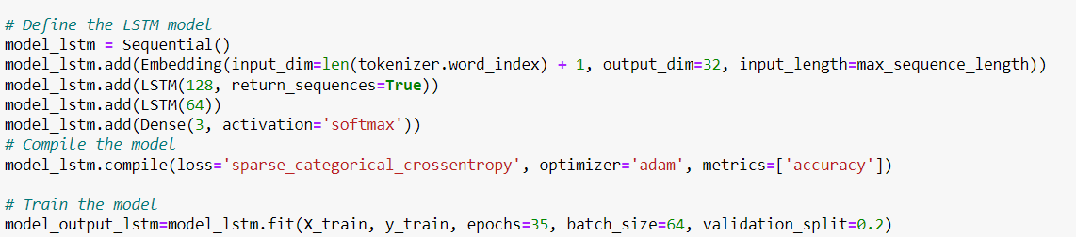
The training accuracy reached approximately 89.82%, which means that, on the training data, the model correctly predicted the host category for about 89.82% of the sequences.
The validation accuracy reached approximately 75.44%. This indicates that the model generalized well to unseen data, as the validation accuracy is close to the training accuracy.
LSTM FOR THREE CLASS CLASSIFICATION:

Slide 21
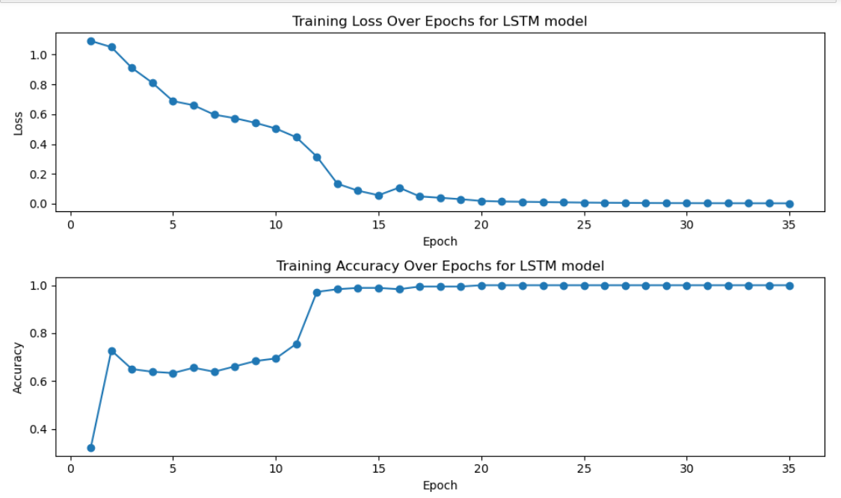
The LSTM model demonstrated strong learning capabilities during training, achieving nearly perfect accuracy on the training data.
However, the model's performance on the validation and test datasets suggests that it might be overfitting to some extent. It may have learned noise or specific details of the training data that do not generalize well.
The observed overfitting in both the LSTM and CNN models can be attributed to the presence of duplicate data in our dataset, particularly for viruses that infect multiple hosts.
These duplicates introduce bias into the training process, as the model may inadvertently memorize repeated examples rather than learning meaningful patterns. As a result, the models perform exceptionally well on the training data but struggle to generalize to unseen data, leading to reduced performance on the validation and test sets.

Slide 22
BUILDING MODELS BY REDUCING THE NUMBER OF CLASSES TO 2 CLASSES:
reducing the classes to "Single-Celled" and "Multi-Celled" organisms simplifies the problem, reduces data redundancy, and encourages the model to learn more generalizable patterns.
Simplified Categories: Grouping viruses into "Single-Celled" and "Multi-Celled" simplifies classification, making it easier for the model to learn and generalize.
Reduced Data Redundancy: Combining similar viruses within each category reduces redundant data, helping the model focus on distinct genetic features.
Enhanced Generalization: Fewer categories encourage the model to learn transferable features, improving predictions on unseen data.
Data Balance: This approach often results in a more balanced dataset, reducing bias towards the majority class.
DATA CONSTRUCTION FOR 2-CLASS MODEL:
In our dataset, we faced challenges with redundant data as viruses often infect multiple host species. To improve the model's performance, we simplified classification by creating two broad categories:
Single-Celled Organisms: This category includes viruses that infect single-celled organisms like bacteria and archaea, focusing on common genetic traits for infecting them.
Multi-Cellular Organisms: This category covers viruses that infect multi-cellular organisms such as plants, animals, and humans, simplifying classification by emphasizing features for infecting multi-cellular hosts.
This preparation step enhances the model's generalization, reducing overfitting and improving predictive accuracy.".

Slide 23
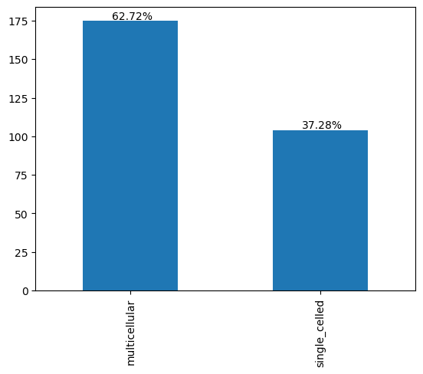
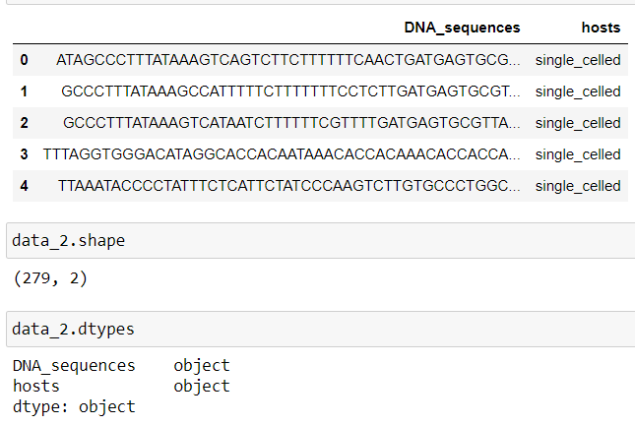
Data Description:
DATA CLEANING
Whitespace Removal
Removal of Special Characters
By meticulously cleaning the data, we ensured that our DNA sequences were devoid of irrelevant characters and ready for subsequent modeling

Slide 24
DATA TRANSFORMATION:
Label Encoding
K-mer Conversion
Count Vectorization
Addressing Class Imbalance: Recognizing the class imbalance issue, we implemented the Synthetic Minority Over-sampling Technique (SMOTE) for oversampling.
Train test split: used to create the training and test data with a test size of 0.3
MODELLING BUILDING:
K-Nearest Neighbours
Multinomial naïve bayes classifier
Decision tree classifier
Random forest classifier
Ensemble models(Adaboost classifier, Gradient boosting classifier,XGBoost classifier)
Naive bayes

Slide 25
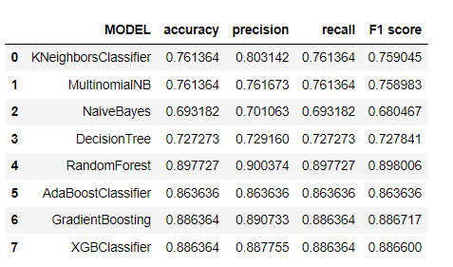
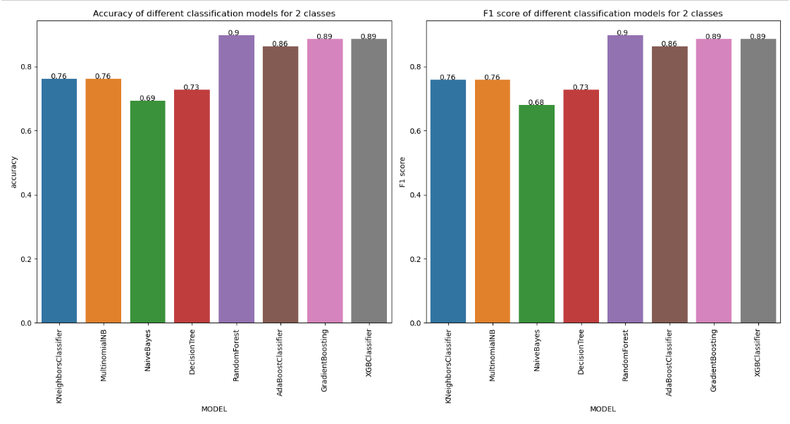
MODEL EVALUATION:
Evaluation metrics of 2 class classification models:
ensemble models, including RandomForest, AdaBoost, GradientBoosting, and XGBClassifier, show higher accuracy compared to previous models.
Approximately 90% accuracy and F1 score, by Random forest ,strong predictive performance.
Precision, Recall, and F1-Score: models achieve balanced precision and recall, resulting in high F1-Scores.
This indicates their ability to effectively distinguish between single-celled and multi-cellular organisms

Slide 26
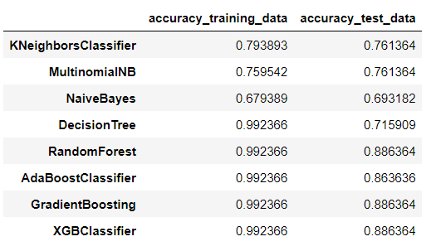
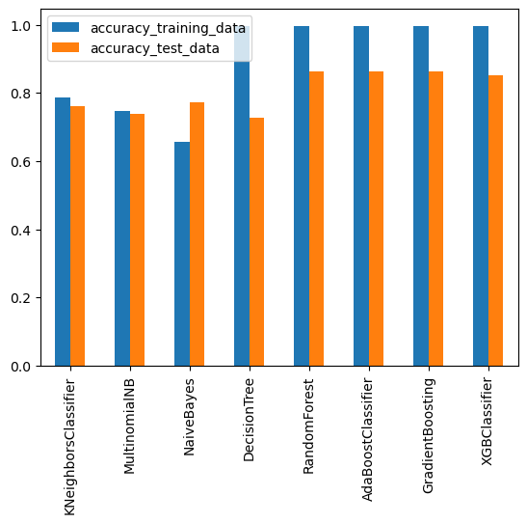
KNeighborsClassifier and MultinomialNB :Accuracy: Around 76.1%, indicating that they correctly classify roughly 76.1% of the instances. Precision, Recall, and F1-Score are balanced, with precision slightly higher than recall, suggesting a good balance between correctly identifying positive and negative instances.
NaiveBayes performs slightly lower than the previous models. Accuracy: Approximately 69.3%, indicating that it correctly classifies about 69.3% of the instances. Precision, Recall, and F1-Score: Similar to KNeighborsClassifier and MultinomialNB, but slightly lower.
DecisionTree exhibits an accuracy of 71.6% on the test data. F1-Score is balanced, suggesting a reasonable trade-off between precision and recall.
ensemble models, including RandomForest, AdaBoost, GradientBoosting, and XGBClassifier, show higher accuracy compared to previous models. Accuracy: Approximately 88.6%, indicating a strong predictive performance:

Slide 27
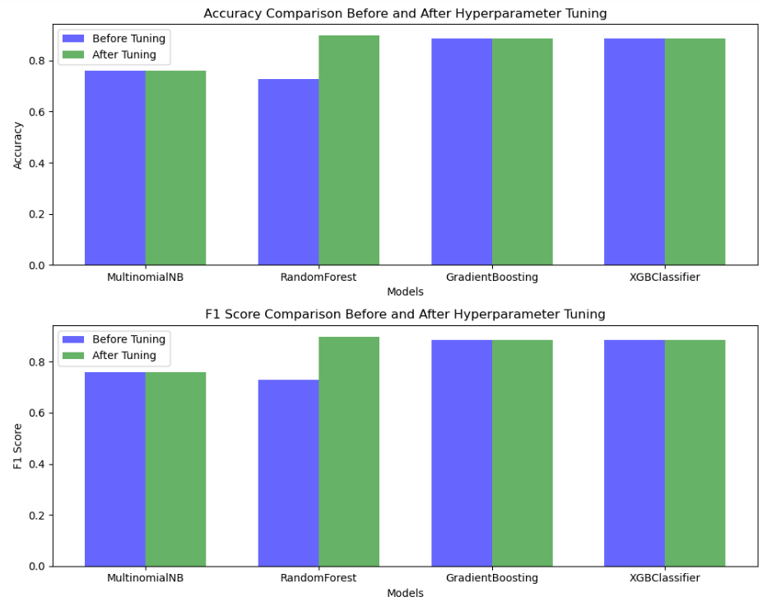
model optimization
Hyperparameter tuning was used to optimize the model. We used gridsearchcv and randomized search methods to tune the hyperparameters for different model
Random Forest demonstrated the most substantial improvement after hyperparameter tuning, with a notable increase in both accuracy(0.72 to 0.89) and F1-score(0.72 to 0.9) , making it the best-performing model
Gradient Boosting maintained good performance even after tuning, with only a slight decrease in the F1-score.
MultinomialNB and XGBoost Classifier did not show significant changes in performance after tuning, with relatively stable accuracy and F1-score.
Overall, Random Forest is the top-performing model, followed closely by Gradient Boosting

Slide 28
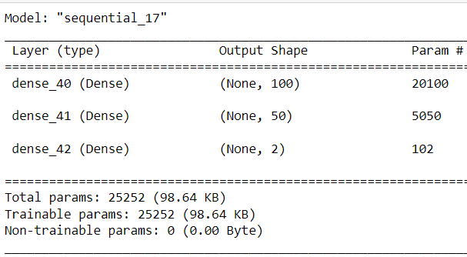
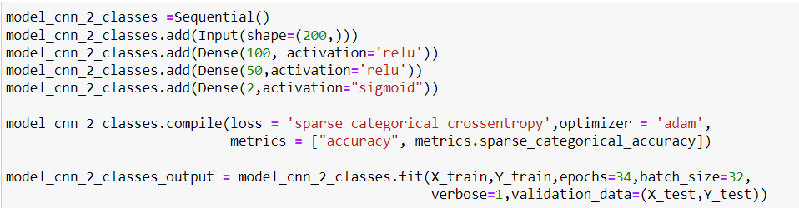
DEEP LEARNING MODELS
Data Transformation:
K-mers Generation
Feature Extraction with Word2Vec: A DocToVec class is defined to convert k-mers into numerical vectors. It uses Word2Vec to represent individual words in the k-mers
Embedding K-mers: The k-mers are embedded into numerical vectors using the DocToVec class, resulting in a vector representation for each DNA sequence.
Label Encoding: The target labels (hosts) are encoded into numerical values using Label Encoding.
CNN MODEL FOR TWO CLASS CLASSIFICATION:

Slide 29
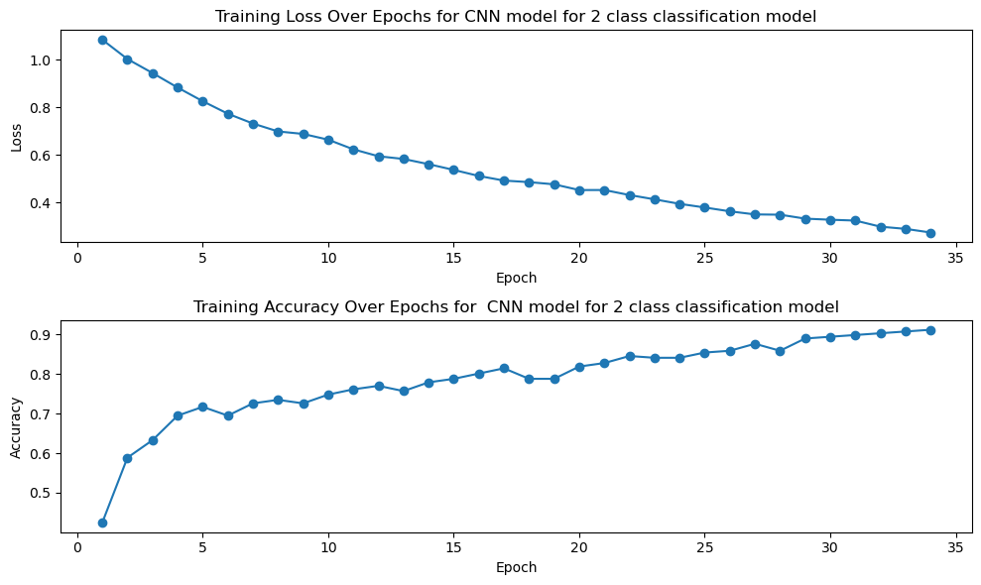
Training Summary:
The CNN model was trained for 34 epochs, with a batch size of 32.
During training, the model exhibited a gradual reduction in the loss function, indicating that it was effectively learning from the data.
The model's accuracy increased as the epochs progressed, reaching a training accuracy of approximately 98.21%.
Validation Summary:
The validation accuracy reached approximately 82.14% by the end of training.
The validation loss, a measure of how well the model generalizes to new data, was approximately 0.5223.
Test Evaluation:.
The test accuracy, which reflects the model's ability to make accurate predictions on new, unseen data, was approximately 82.14%.
The test loss, which quantifies the difference between predicted and actual values, was approximately 0.5223.

Slide 30
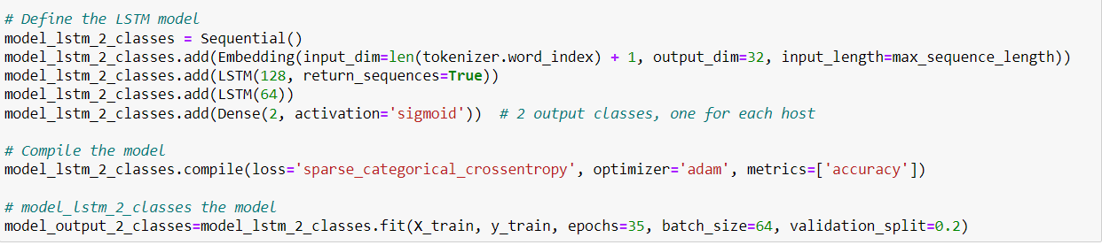
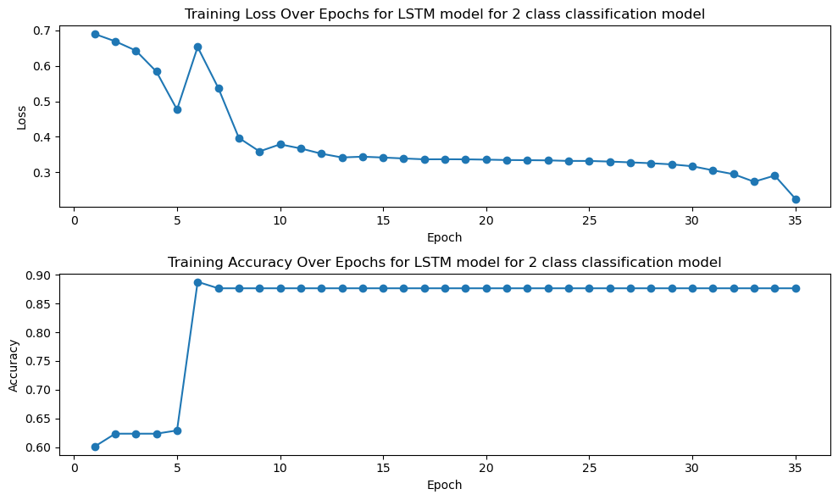
LSTM MODEL FOR TWO CLASS CLASSIFICATION:

Slide 31
Training and Validation:
The LSTM model was trained over 35 epochs, with each epoch processing data in batches.
During training, the model achieved an accuracy of approximately 87.64% on the training dataset.
The validation accuracy consistently remained around 71.11%, indicating moderate generalization performance.
The training loss gradually decreased from an initial value of 0.6901 to 0.2252 by the end of training.
The validation loss followed a similar trend, decreasing from 0.6752 to 0.6695.
Test Evaluation:
The test accuracy was approximately 58.93%, indicating a lower performance compared to the training and validation phases.
The test loss was 0.8946, which is notably higher than the training and validation losses.
The LSTM model appears to perform well during training and validation, achieving high accuracy and gradually reducing loss.
However, when evaluated on unseen test data, the model's accuracy drops, suggesting potential overfitting to the training data.
Further investigation, including hyperparameter tuning or potentially adjusting the model architecture, might be necessary to improve test performance.

Slide 32
CONCLUSION:
8-Class Classification:
Models: Multinomial Naive Bayes, Random Forest, Gradient Boosting, XGBoost performed well.
AdaBoost lagged behind; optimization recommended.
Stratified K-Folds:
Used to mitigate data imbalance.
Random Forest and K-Nearest Neighbors had 40% accuracy.
Multinomial Naive Bayes showed balanced performance.
AdaBoost performed poorly, Gradient Boosting showed promise.
Reduced Classes (Three & Two):
Random Forest excelled as the top-performing model.
Simplified problem and improved generalization.
Deep Learning Models:
CNN achieved ~51.85% accuracy.
LSTM struggled with generalization, achieving 29.63% accuracy.
Ensemble methods (RandomForest, Gradient Boosting, XGBClassifier) excelled in three-class classification.
Simplifying to two classes improved performance.
Binary Classification:
CNN reached ~82.14% accuracy.
LSTM showed potential overfitting.
Key Takeaways:
Emphasize data preprocessing, hyperparameter tuning, and model selection for robust host classification.

Slide 33
LIMITATIONS
Data Quality and Quantity
Limited availability of high-quality viral DNA data
Imbalanced datasets for underrepresented host classes
Data bias from duplicate or overrepresented data
Model Performance
Complex 8-class virus classification
Moderate accuracy even with the best models
Need for model refinement and feature engineering
Challenge of interpreting deep learning models
Generalization
Models may not generalize to new, unseen data
Consider regularization and transfer learning
Computational Resources
Some models, like deep learning, are computationally intensive
Limitations in resource-constrained environments
Ethical Considerations
Robust data privacy measures essential for genetic data
Real-World Variability
Biological variability among viruses and hosts can be substantial
Models may not account for this variability adequately

Slide 34
ENHANCEMENTS AND MITIGATIONS
Data Augmentation
Enhance dataset with diverse examples
Address data imbalances for better generalization
Feature Engineering
Extract informative features from DNA sequences
Explore domain-specific feature engineering
Regularization Techniques
Mitigate overfitting with techniques like dropout layers, batch normalization, and weight regularization
Transfer Learning
Improve performance by fine-tuning pre-trained models for virus-host classification
Interpretability
Gain insights into model decisions with techniques like feature importance analysis and attention mechanisms
Ethical Framework
Prioritize data handling ethics, including informed consent and data anonymization
Computational Efficiency
Optimize efficiency with lightweight model architectures and model quantization
Biological Insights
Collaborate with virology and genomics experts for deeper biological understanding

Slide 35
THANK YOU

